Slide 1
NLP Restaurant Search Engine
Steve Kim
Capstone Two Project
Springboard Data Science
Jan, 2020

Slide 2
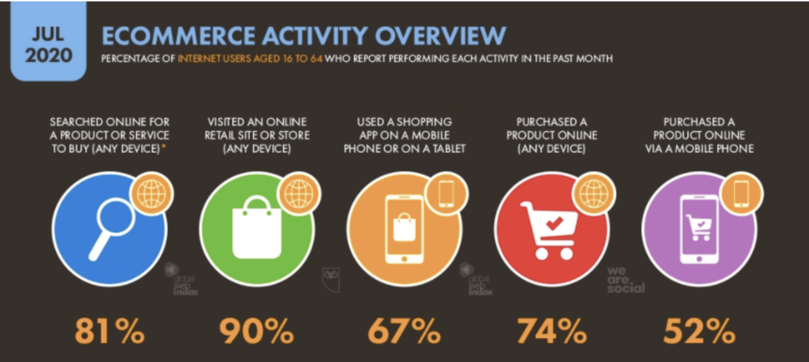
Search Engine and Project Goal
Search engines are used everywhere (“google it”)
E-commerce: Amazon, Target, Walmart, etc.
Online listings: Airbnb, Yelp, etc.
Entertainment: Netflix, HBO Max, Youtube, etc.
Users relies heavily on search engines
Users searches for various information. For example, consumers searches for various products, software engineers looks for solution to the bug using google and stack overflow.
Capstone Project Goal
Listing relevant restaurants when typing in specific ingredients or cuisine name (i.e. ‘galbi bulgogi).

Slide 3
Approach
Data Acquisition and wrangling
Gather relevant csv files.
Web-scraping restaurants’ menu data.
EDA
Visualize restaurants’ similarities based on its attributes.
Visualize common unigrams, bigrams, and trigrams.
Identify common words in each cuisines.
LDA topic modeling.
Building Doc2Vec and TF-IDF models
Build three Doc2Vec models based on the following:
Yelp’s Review/Tips text values
Menu description
Menu title
Build TF-IDF model based on relevant keywords.

Slide 4
Target Audience
Restaurant Search Engine is useful for all parties
Food enthusiasts and travelers looking for specific taste and/or atmosphere.
General public looking for places to dine or take-out.
Search engine can be changed for different applications
Search engine can be converted to look for academic documents or any retail products.

Slide 5
Dataset
Yelp Dataset
8,021,122 reviews
209,393 businesses
1,320,710 tips
Over 1.4 million business attributes.
Yummly Dataset
20 cuisines (Korean, Spanish, etc.)
36,568 ingredients
Allmenus (web-scraped)
12,000+ restaurants
1,000,000+ menus

Slide 6
Data Wrangling
Text Pre-processing
Expanded contractions, tokenized, lemmatized, lowercased, removed stop words and extra white spaces to all text values.
Filtered restaurant list down to 1,199 unique restaurants spanning across 22 U.S states.
Dropped rows with non-english language.
Data Quality Check
Ensured there were no NaN values in any of the text columns.

Slide 7
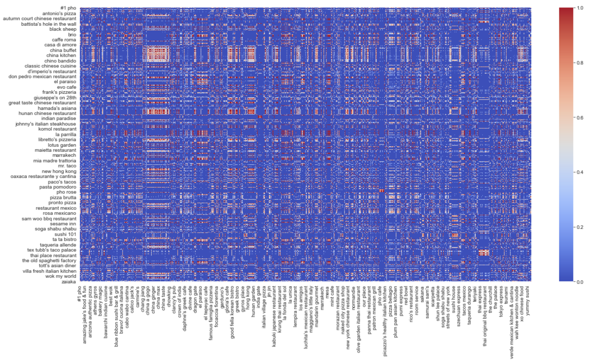
EDA - Similarities between Restaurants
Identified restaurants’ similarities using cosine similarity and Seaborn’s heatmap.

Slide 8
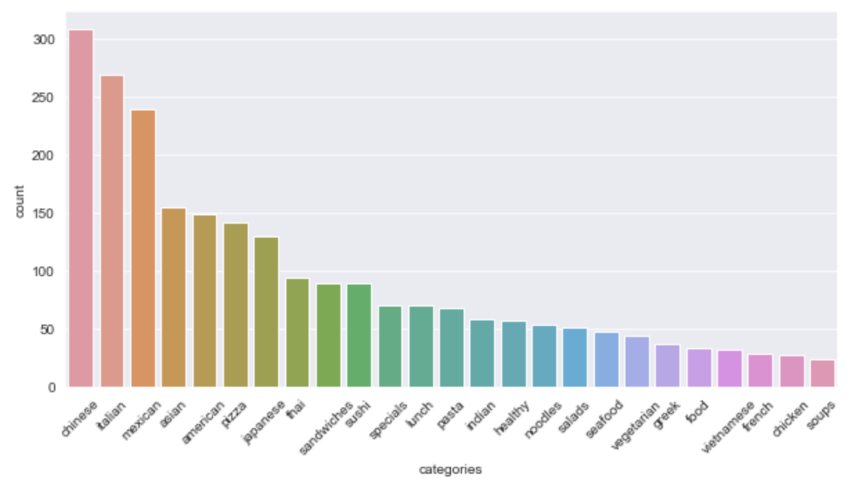
EDA - Top 25 Most Occurring Cuisines
Top 3 most occurring cuisines are ‘Chinese’, ‘Italian’, and ‘Mexican’.

Slide 9
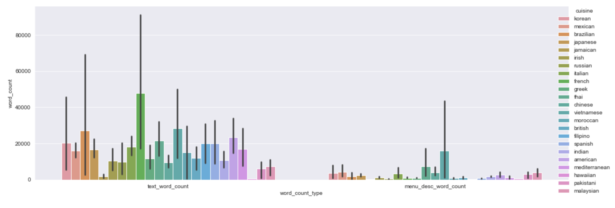
EDA - Word Count on each Cuisine
French cuisine has the most word count compared to other cuisines although not many French restaurants appeared in restaurants’ list. Furthermore, error bars are apparent on most cuisines which means that word counts are highly spread out from 3,000 to 100 words per document.

Slide 10
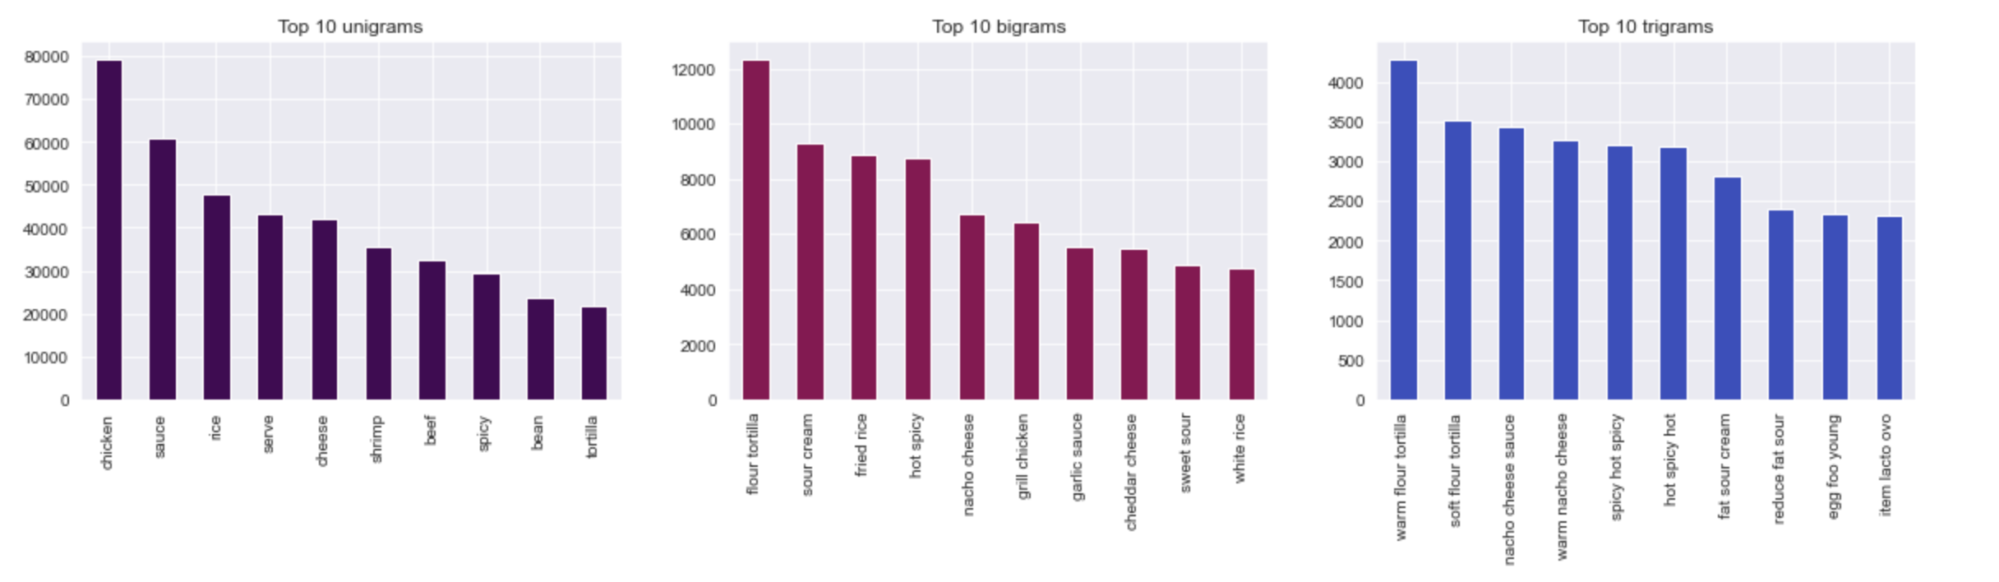
EDA - Distribution of Unigram, Bigrams, and Trigrams
The top 10 most common words from unigrams, bigrams, and trigrams are flour, spicy, tortilla, sauce, and milk related terms.

Slide 11
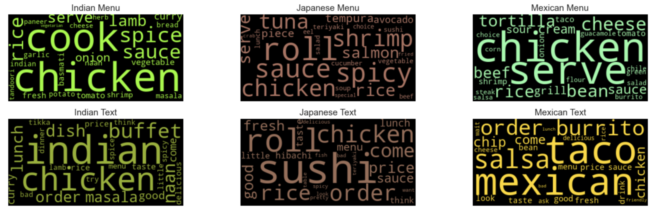
EDA - Top keywords of each Cuisines based on TF-IDF
Validated top keywords per cuisines. Japanese cuisine contained mostly fish or sushi related terms such as ‘tuna’, ‘roll’, ‘salmon’, ‘rice’, etc.

Slide 12
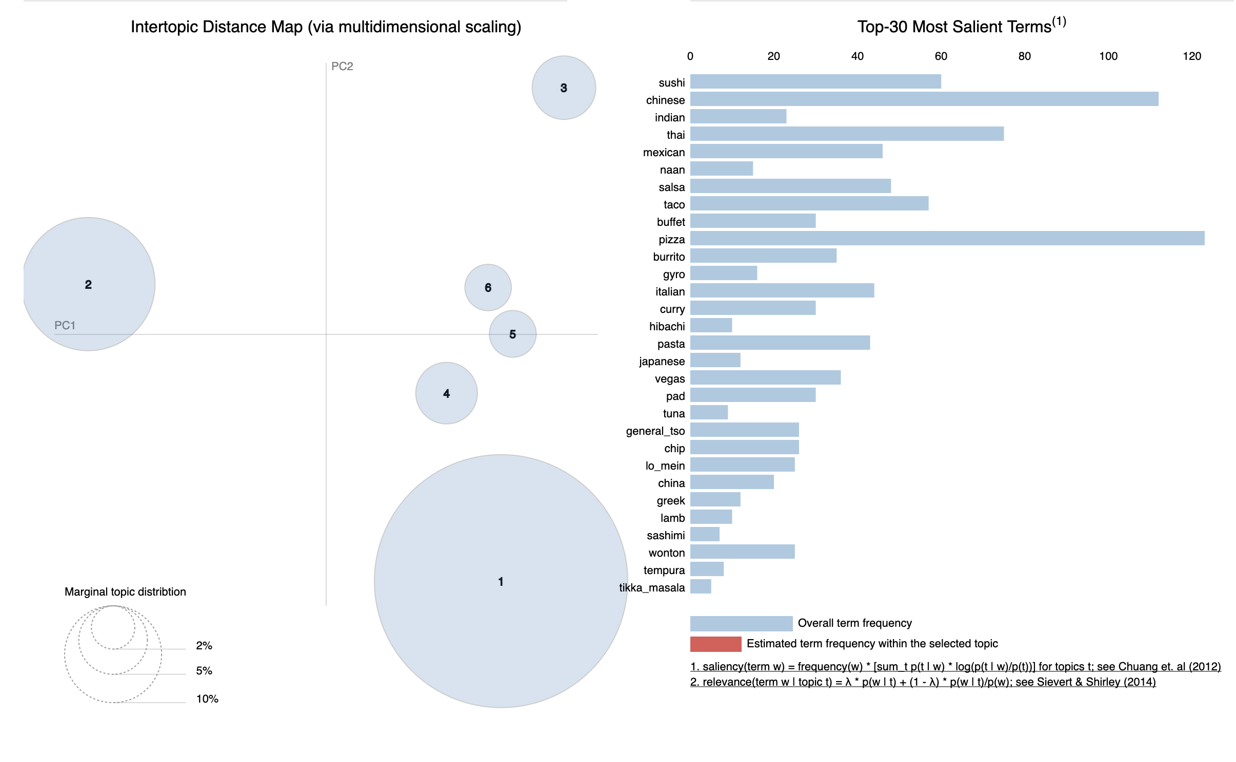
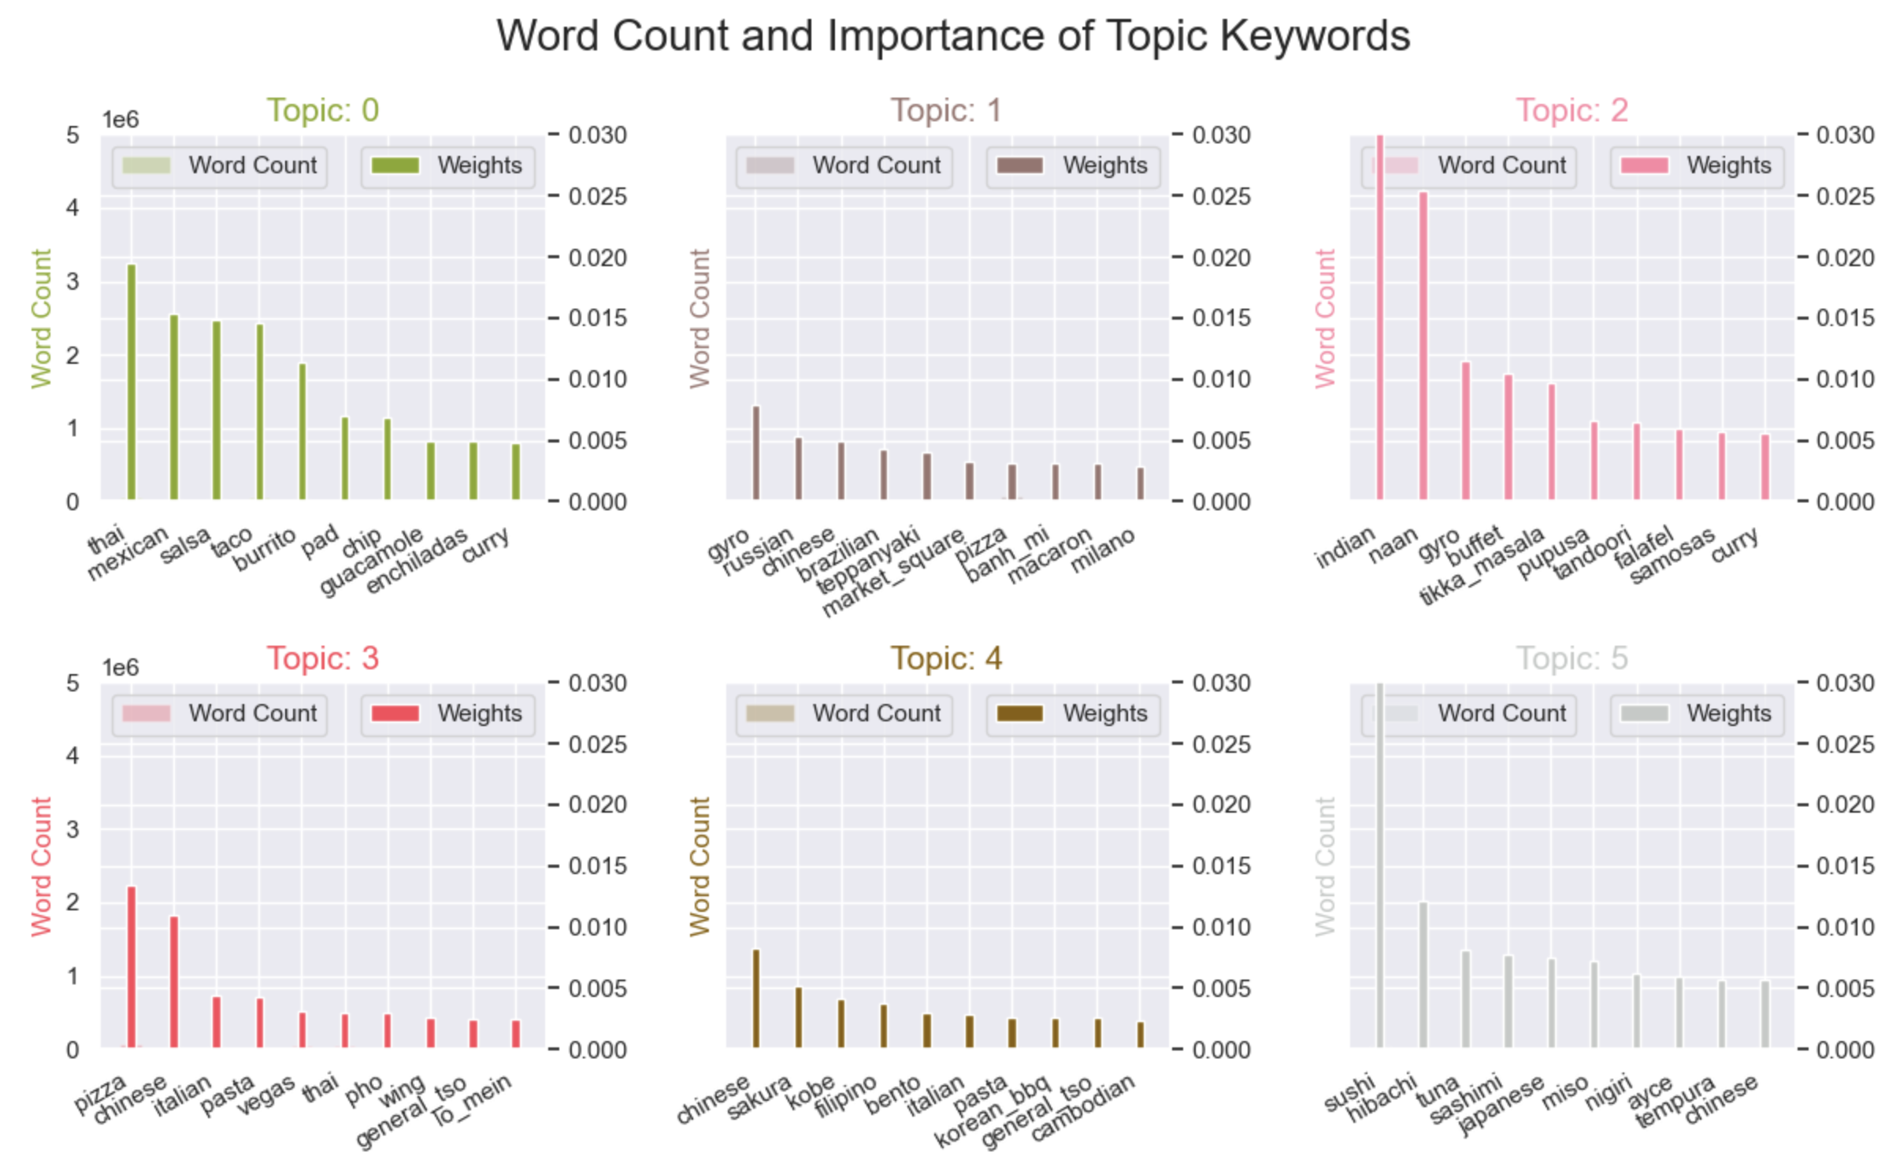
EDA - LDA Topic Modeling
Based on LDA model, six topics are the ideal topic count for Yelp’s text values. However, due to general terminologies used throughout Yelp’s review text, some were challenging understand more coherently.
Topic 0 - Hispanic/Mexican
Topic 1 - Traditional dishes or places(?)
Topic 2 - Indian
Topic 3 - Bread, Noodles, and starch (?)
Topic 4 - Meat(?)
Topic 5 - Japanese

Slide 13
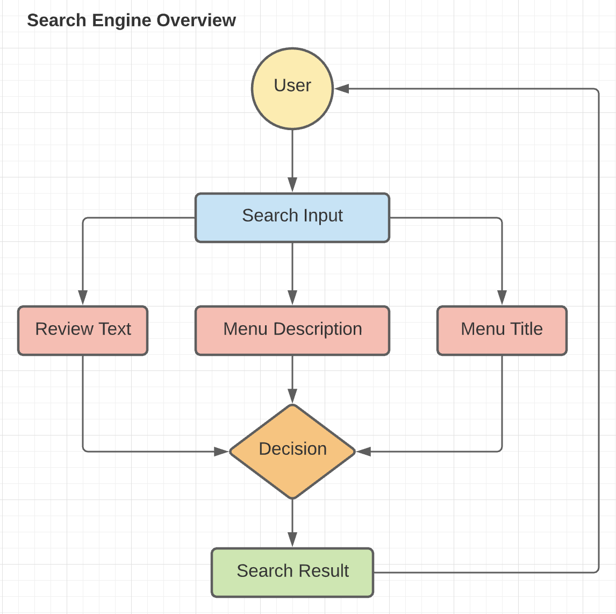
NLP Search Engine - Overview
Three Doc2Vec models will be built and trained:
Yelp’s Review/Tips text values
Menu Description
Menu Title
The image on the side is basic overview on how relevant restaurants will be created.

Slide 14
NLP - How relevant listings are populated
The idea behind building three Doc2Vec models is to consolidate search results which consists of most similar documents based on the user's search query using cosine similarity and built-in Doc2Vec's most_similar method. The top 10 documents will be chosen in one of following ways:
When there are common documents populated in all three results; the document will be added as part of the final result. For instance, when a restaurant named 'Panda Express' is shown in all three Doc2Vec results, Panda Express will be shown as part of the final result visible to the user.
When similar restaurant names do not accumulate up to 10; the rest will be determined based on cosine similarity score.
When no common documents are found through three Doc2Vec results, all three results will be consolidated and results will be shown based on cosine similarity score in descending order.

Slide 15
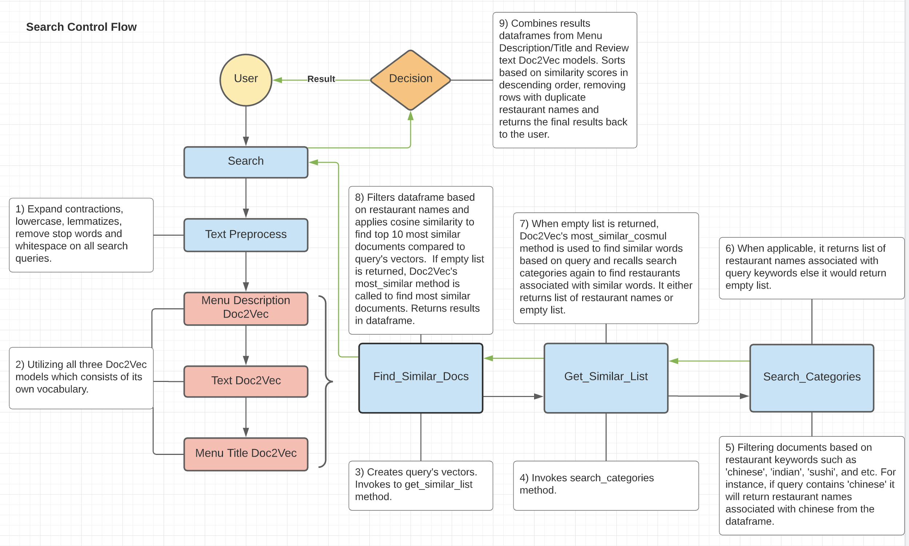
NLP - Detailed Search Engine Control Flow

Slide 16
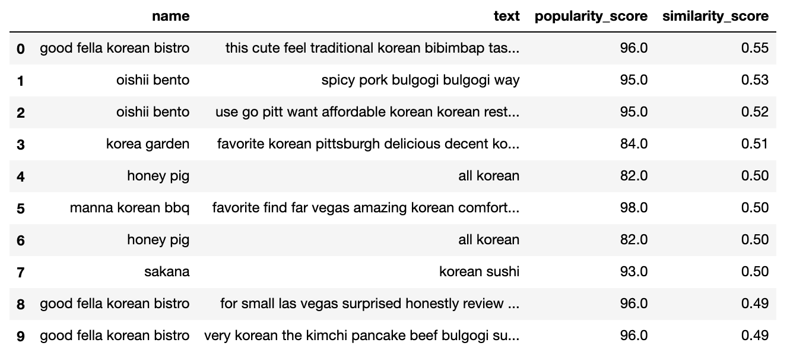
NLP - TF-IDF Approach
Created similarity matrix between a list of keywords based on TF-IDF and used Gensim’s Matrix Similarity method in populating the result. The ‘korean bulgogi food’ search input returned the following result:

Slide 17
Suggested Improvements
There are several ways to improve performances in identifying similar restaurants based on the user's search query.
Using all of Yelp’s review text data instead of trimming down based on what was available on allmenus.com. At the end of my NLP project, I recognized that using a combination of LDA and Word2Vec/Doc2Vec, I could have found restaurants’ cuisine type without use of allmenus’ menu text data through topic modeling (clustering). Using this approach, may have provided more restaurants to search.
Currently, the search engine populates based on similarity score only, the search result may be more relevant when populating list based on user’s location. For instance, if a user queried from Los Angeles, it would show restaurants near that area.
Utilizing Spark or Dask in speeding up computational time in text pre-processing and populating search results.

Slide 18
Summary
Search engine was built with the purpose of finding most similar restaurants based on user query whether it may be food, drink, or any restaurant’s attributes.
During the EDA process, we were able to differentiate and visualize text values based on cuisines (ex: ‘Japanese’, ‘Chinese’, ‘French’, and etc.).
Created three Doc2Vec models based on Yelp’s review text data and allmenus’ menu data which provided coherent results in providing good results.
The TF-IDF search model was created based on keywords which also provided coherent results but unlike Doc2Vec models it does not understand meaning of the words and semantic relationships between words and documents.

Slide 19
Acknowledgement
Ajith Patnaik (Mentor)

Slide 20
Reference
Detailed Project Report
Data Wrangling & Text Pre-processing
EDA
Doc2Vec and TF-IDF Model Building
Helper functions (search engine control flow)
Project GitHub Repository

